Slide 1
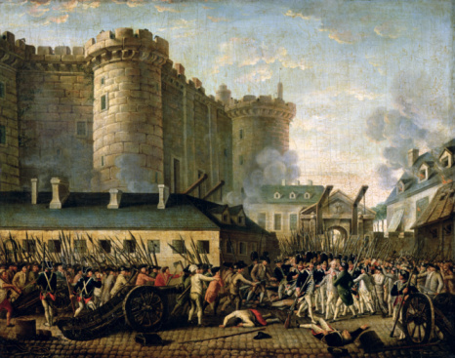
Coming of the French Revolution

Slide 2
Objectives
Describe the social divisions of France’s old order.
List reasons for France’s economic troubles in 1789.
Explain why Louis XVI called the Estates-General and summarize what resulted.
Understand why Parisians stormed the Bastille.

Slide 3
Terms and People
ancien régime – the government in pre-revolution France
estate – social class
bourgeoisie – the middle class
deficit spending – when a government spends more money than it takes in

Slide 4
Terms and People (continued)
Louis XVI – king of France from 1774 to 1792; executed in 1793
Jacques Necker – a financial advisor to Louis XVI
Estates-General – the legislative body consisting of representatives of the three estates
cahier – notebook used during the French Revolution to record grievances

Slide 5
Terms and People (continued)
Tennis Court Oath – an oath taken by the members of the National Assembly to meet wherever the circumstances might require until they had created a constitution
Bastille – fortress in Paris used as a prison; French Revolution began when Parisians stormed it in 1789

Slide 6
What led to the storming of the Bastille, and therefore, to the start of the French Revolution?
A volatile atmosphere in France resulted from a widespread famine and the influence of reformers inspired by Enlightenment ideas.
The situation exploded on July 14, 1789.

Slide 7
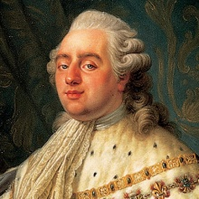
In 1789, France’s society was based on a system created in the Middle Ages. The ancien régime separated everyone in French society into one of three estates:
First Estate
Clergy
King not included
Second Estate
Nobility
Third Estate
About 95 percent of the
population, including the bourgeoisie, urban workers, and rural peasants
Notes:
7

Slide 8
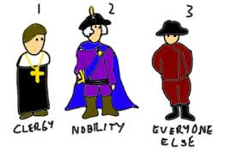

Slide 9
The first two estates enjoyed most of the wealth and privileges of France.
The Church | The nobility
Owned 10 percent of the land Collected tithes Paid no direct taxes to the state | Had right to top jobs in government, the army, the courts, and the Church Paid no taxes
Notes:
9

Slide 10
At all levels, members of the Third Estate had reason to resent the existing social order.
Even wealthy members of the bourgeoisie did not have access to the best government positions.
Urban workers earned pitiful wages and faced starvation whenever the price of bread rose.
Rural peasants owed fees and services that dated back to feudal times.
The
Bourgeoisie
As Enlightenment ideas spread among the Third Estate, many began to question the ancien régime.

Slide 11
Economic troubles added to the social unrest and heightened tensions.
Years of deficit spending had put the government deeply in debt. The money had been spent on:
Louis XIV’s lavish court
the Seven Years’ War
support for Patriots in the American Revolution
rising costs of goods and services
Bad harvests in the 1780s made it harder to recoup this money.

Slide 12
To solve the financial crisis, the government had to increase taxes, reduce expenses, or both.
The first two estates resisted any attempts to make them pay taxes.
Louis XV ran up more debt.
Louis XVI was weak but attempted some economic reforms.

Slide 13
Reduce extravagant court spending
Reform government
Abolish tariffs on internal trade
Tax the First and Second Estates
Louis XVI appointed Jacques Necker as his financial advisor. Necker made recommendations to reduce the debt:
When Necker proposed taxing the First and Second Estates, the nobles and high clergy forced Louis XVI to dismiss him.

Slide 14
The pressure for reforms mounted, but the powerful classes demanded that the king summon a meeting of the Estates-General.
In the meantime, France was on the verge of bankruptcy.
Rising prices led to bread riots.
Nobles continued to fight against taxes.
The nobles hoped that the Estates-General could bring the absolute monarch under their control and guarantee their own privileges.

Slide 15
Before the meeting, Louis had all the estates prepare cahiers listing their grievances.
Fairer taxes!
Freedom of the press!
Regular meetings of the Estates-General!
Many delegates from the Third Estate wanted to solve the financial crisis, but insisted on reforms.

Slide 16
The voting system created a stalemate, because each estate traditionally met separately and had one vote.
1 vote
Third Estate
1 vote
First Estate
1 vote
Second Estate
The Third Estate moved to create a fairer system in which the three estates met together and votes were counted by heads rather than estates.

Slide 17
In June 1789, after weeks of stalemate, members of the Third Estate declared themselves to be the National Assembly and the true representatives of the people.
They were locked out of their meeting hall and moved to a nearby tennis court.
The members of the National Assembly took the Tennis Court Oath. They pledged to continue meeting until a constitution was established.

Slide 18
Some reform-minded clergy and nobles joined the Third Estate in the National Assembly.
Louis XVI was forced to accept the new body.
But when royal troops gathered in Paris, rumors spread that the king planned to dissolve the National Assembly.

Slide 19
On July 14, 1789, events erupted into revolution with the storming of the Bastille.
A crowd gathered outside the prison to demand weapons they thought were stored there.
The commander fired on the crowd, killing many. The mob broke through, freeing prisoners but finding no weapons.
The fall of the Bastille challenged the existence of the ancien régime.

Slide 20
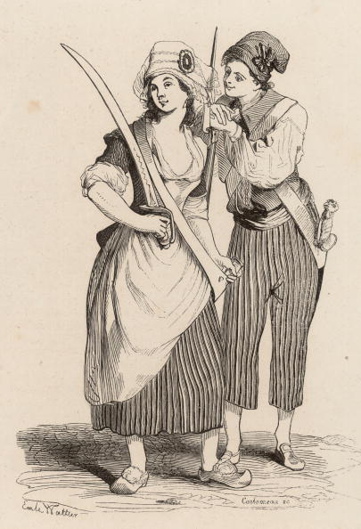
Early Stages of the French Revolution

Slide 21
Objectives
Explain how the political crisis of 1789 led to popular revolts.
Summarize the moderate reforms enacted by the National Assembly in August 1789.
Identify additional actions taken by the National Assembly as it pressed onward.
Analyze how other European nations reacted to the events unfolding in France.

Slide 22
Terms and People
factions – dissenting groups of people
Marquis de Lafayette – the leader of the National Guard, a largely middle-class militia; fought alongside George Washington in the American Revolution
Olympe de Gouges – a journalist who believed that the Declaration of the Rights of Man should grant equal citizenship to women
Marie Antoinette – Austrian-born queen of France; Louis XVI’s wife

Slide 23
Terms and People (continued)
émigré – a person who flees his or her country for political reasons
sans-culottes – working-class men and women who made the French Revolution more radical
republic – system of government in which officials are chosen by the people
Jacobins – members of a revolutionary political club made during the French Revolution

Slide 24
What political and social reforms did the National Assembly institute in the first stage of the French Revolution?
The members of the National Assembly voted to end their own privileges after the storming of the Bastille.
From providing equal rights to all male citizens before the law, to the abolishment of their exclusion from taxes, the National Assembly aimed to change an unjust system.

Slide 25
Historians have divided the period of the French Revolution into four different phases.
National Assembly | France became a constitutional monarchy
Reign of Terror | A radical phase with escalating violence End of the monarchy
Directory | A period of reaction against extremism
Age of Napoleon | Consolidation of many changes A period of war throughout Europe

Slide 26
The political crisis of 1789 in France coincided with the worst famine in memory.
Rumors were rampant and created panic.
During the period known as the “Great Fear,” peasants believed that government troops were seizing their crops.
Believing that nobles were trying to reinstate medieval dues, peasants stole grain and set fire to old manor records.
Although the violence died down, peasant anger against the ancient regime remained high.

Slide 27
In Paris, the revolutionary center of France, several factions competed for power.
National Guard | Moderate Led by the Marquis de Lafayette A mainly middle-class militia
Paris Commune | Radical Replaced the royalist government of Paris Mobilized violent action for the revolution

Slide 28
The National Assembly reacted to the uprisings and voted to end the privileges of the nobility.
Nobles gave up old manorial dues and exclusive hunting rights.
Nobles ended their special legal status and their exemptions from paying taxes.
The assembly enacted the equality of all male citizens before the law.

Slide 29
At the end of August, 1789, the National Assembly issued the Declaration of the Rights of Man and the Citizen.
Free and equal rights for all men
Natural rights for all men
Equality before the law for all men
Freedom of religion for all citizens
Taxes levied fairly for all citizens
Modeled after the American Declaration of Independence, it announced

Slide 30
The Declaration of the Rights of Man did not please everyone.
Women such as Olympe de Gouges called for equal citizenship for women.
Louis XVI did not want to accept the reforms of the National Assembly.

Slide 31
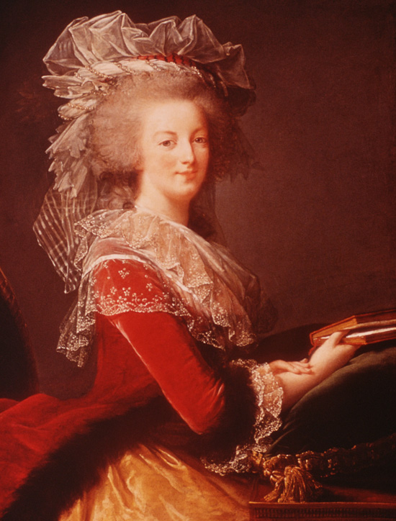
Some 6,000 women marched on Versailles on October 5, 1789.
They were angry about the famine resented Queen Marie Antoinette, who lived a life of luxury
They demanded to see the king.
The women brought the king and queen to Paris, where they lived as virtual prisoners.

Slide 32
The National Assembly placed the Church under state control.
It dissolved convents and monasteries.
It ended papal authority over the French Church.
The Civil Constitution of the Clergy made bishops and priests elected, salaried officials.
This move was condemned by the pope, many bishops and priests, and large numbers of French peasants.

Slide 33
The National Assembly produced the Constitution of 1791. This set up a limited monarchy.
Make laws
Collect taxes
Decide on issues of war and peace
The new Legislative Assembly had the power to
Moderate reformers considered that the Constitution of 1791 completed the French Revolution.

Slide 34
At the time of the creation of the Constitution of 1791, Louis XVI and Marie Antoinette attempted to escape France.
As French émigrés spread fear of revolution in other nations, France prepared for war.
To many, this attempt meant that Louis was a traitor to the revolution.
The emperor of Austria and king of Prussia signed the Declaration of Pilnitz supporting Louis and threatening to intervene.

Slide 35
The sans-culottes and the Jacobins pushed the revolution to more radical action.
Sans-culottes demanded a republic and an end to monarchy.
Jacobins gained the upper hand in the Legislative Assembly and declared war on Austria, Prussia, Britain, and other states.
Fighting began in 1792 and lasted on and off until 1815.
Sans-culottes

Slide 36
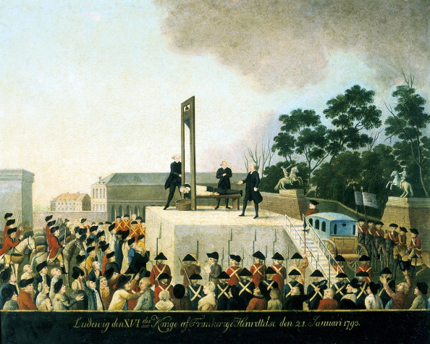
Radical Period of the French Revolution

Slide 37
Objectives
Understand how and why radicals abolished the monarchy.
Explain why the Committee of Public Safety was created and why the Reign of Terror resulted.
Summarize how the excesses of the Convention led to the formation of the Directory.
Analyze how the French people were affected by the changes brought about by the revolution.

Slide 38
Terms and People
suffrage – the right to vote
Robespierre – leader of the Committee of Public Safety; chief architect of the Reign of Terror
Reign of Terror – period from September 1793 to July 1794 when those who resisted the French Revolution were arrested or executed
guillotine – a bladed execution device used during the French Revolution

Slide 39
Terms and People (continued)
Napoleon – popular military hero who became ruler of France
nationalism – a strong feeling of pride in and devotion to one’s country
Marseilles – port city in France; the French national anthem was named after it

Slide 40
What events occurred during the radical phase of the French Revolution?
Initially, the monarchy was abolished and a republic was established. War continued throughout Europe.
After the radicals gained control, those who were against the revolution were subject to arrest or execution. Thousands, including the king and queen, were beheaded at the guillotine.

Slide 41
In 1792, the war abroad was going badly for the French.
Many revolutionaries believed that the king was in league with foreign powers to retain his power.
Citizens attacked the palace where the king was held. The king and his family escaped to the Legislative Assembly.
Citizens also attacked prisons that held nobles and priests.
Tensions led to increasing violence.

Slide 42
Radicals took control of the Legislative Assembly and called for the election of a new legislative body—the National Convention.
National Convention
Extended suffrage to all male citizens.
Seized nobles’ lands.
In addition, the monarchy was abolished in favor of the creation of a republic.

Slide 43
The National Convention put Louis XVI on trial as a traitor to France. He was sentenced to death.
In January 1793, Louis XVI was beheaded.
In October 1793, Marie Antoinette was beheaded.

Slide 44
By 1793, France faced external and internal threats.
War continued with the Netherlands, Spain, Britain, and Prussia.
Royalists and priests led rebellions against the government.
The sans-culottes demanded relief from food shortages and inflation.
The Convention was divided between the Jacobins and the Girondins.
The Convention created the Committee of Public Safety to deal with these issues.

Slide 45
The National Convention granted the Committee of Public Safety absolute power to save the revolution.
At war,
French armies overran the Netherlands and invaded Italy.
At home,
France battled counter-revolutionaries through the use of terror.

Slide 46
Maximilien Robespierre (the Incorruptible) became the leader of the Committee of Public Safety.
Promoted religious tolerance
Tried to abolish slavery
Believed in general will above all. Rousseau
Arrested and tried all those who threatened the revolution
He was a reformer, but also supported terror as a way to maintain order.
Nearly 300,000 people were arrested and 17,000 executed by guillotine for opposing the revolution. The Reign of Terror continued until Robespierre himself was executed in 1794.

Slide 47
In reaction to the Reign of Terror, moderates produced the Constitution of 1795.
The Constitution created a five-man Directory and a two-house legislature. The Directory:
Made peace with Prussia and Spain
Continued the war with Austria and Great Britain
Created a constitutional monarchy
The Directory was corrupt and did not solve problems such as rising bread prices. They appointed Napoleon Bonaparte, a popular military hero, to rule France.

Slide 48
By 1799, France had changed dramatically from the country of Louis XVI and his court.
The term citizen applied to people of all social classes.
Elaborate fashions gave way to simple clothing.
Nationalism rose throughout France. Troops in Marseilles marched to a rousing song that would later become the French national anthem.
State schools replaced religious ones.
Social systems were organized to help the poor, old soldiers, and war widows.

Slide 49
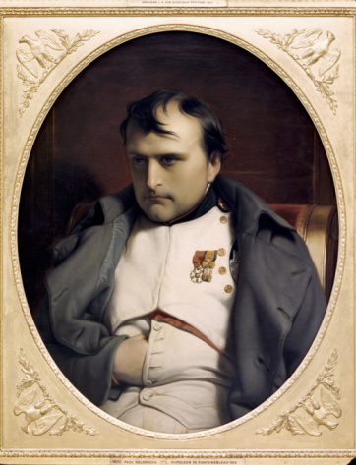
The Age of Napoleon Section 4

Slide 50
Objectives
Understand Napoleon’s rise to power and why the French strongly supported him.
Explain how Napoleon built an empire and what challenges the empire faced.
Analyze the events that led to Napoleon’s downfall.
Outline how the Congress of Vienna tried to create a lasting peace.

Slide 51
Terms and People
plebiscite – a popular vote by ballot
Napoleonic Code – the code of laws created under Napoleon that embodied enlightenment principles of equality, tolerance, and freedom
annex – add territory to an existing state, country, or empire
Continental System – a form of economic warfare that closed European ports to British goods; the foreign policy in which Europe adopted Napoleon’s reforms

Slide 52
Terms and People (continued)
guerrilla warfare – a form of warfare using hit-and-run raids
scorched-earth policy – when the movement of an army includes burning crops and villages to make it difficult for the enemy to follow
abdicate – step down from power
Congress of Vienna – a meeting of heads of state within Europe after Waterloo to restore stability and order in Europe

Slide 53
Terms and People (continued)
legitimacy – principle by which monarchies that had been unseated by the French Revolution or Napoleon were restored
Concert of Europe – a system in which the powers of Europe met periodically to discuss any problems affecting the peace in Europe

Slide 54
Explain Napoleon’s rise to power in Europe, his subsequent defeat, and how the outcome still affects Europe today.
Napoleon rose to power in the midst of near-chaos in France. His successes on the battlefield along with his strong governmental control encouraged a French nationalism that brought Europe to its knees.
Napoleon’s laws were spread throughout Europe during the expansion and remain important in many countries today.

Slide 55
Napoleon Bonaparte was a military hero who rose quickly through the army. He favored republican rule and the Jacobins.
1793 | Drove British forces from Toulon Won victories against the Austrians Captured most of northern Italy
1798 | Lost in Egypt, but hid news of his worst losses by censoring the press
1799 | Overthrew the Directory and set up a three-man governing board known as the Consulate
Notes:
55

Slide 56
When Napoleon helped create the Consulate, he became First Consul.
In 1802, Napoleon became consul for life.
Two years later, he crowned himself Emperor of the French.
At each step, Napoleon had held a plebiscite and been strongly supported by the French people.

Slide 57
Napoleon restored order and prosperity and strengthened the central government. He:
His policies gained him support among all social classes. He:
Made peace with the Church
Encouraged émigrés to return
Recognized peasants’ right to lands they had gained
Opened jobs to all based on talent
Controlled prices
Encouraged industry
Built roads and canals
Set up public schools

Slide 58
His most lasting reform was a new code of laws known as the Napoleonic Code.
The code embodied Enlightenment principles.
But women lost most of their rights of citizenship.
Napoleonic Code
Equality of all male citizens before the law
Religious toleration
Abolition of feudalism

Slide 59
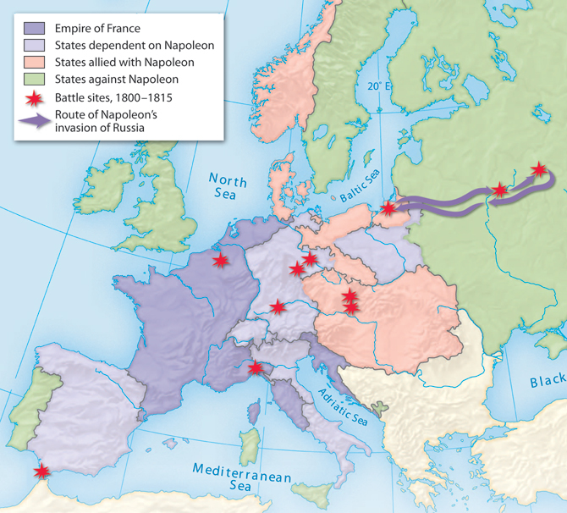
From 1804 to 1812, Napoleon successfully battled most of Europe and created an empire.
France annexed the Netherlands, Belgium, and parts of Italy and Germany.
Napoleon cut Prussian territory in half and abolished the Holy Roman Empire.
He placed his own relatives on some European thrones.

Slide 60
Britain was the only major European power to remain outside of Napoleon’s empire.
The British navy smashed the French fleet in the Battle of Trafalgar in 1805, ending Napoleon’s plans to invade Britain.
Napoleon then imposed the Continental System to close European ports to British goods.
The blockades created some hardships but Britain was able to maintain its trade routes in India and the Americas.

Slide 61
Many Europeans who had welcomed the ideas of the French Revolution saw Napoleon and his army as oppressors.
In Spain, people resisted reforms that undermined the king and the Catholic Church.
Nationalism in occupied countries created revolts and patriotic resistance through guerrilla warfare.

Slide 62
Napoleon’s disastrous invasion of Russia in 1812 was a turning point in the Napoleonic Wars.
The tsar initially supported Napoleon but ended up withdrawing from the Continental System.
When Napoleon attacked, the retreating Russian army used a scorched-earth policy that made it impossible for Napoleon’s army to survive on what they left.
Faced with the brutal Russian winter, Napoleon retreated, losing most of his army. Russia, Britain, Prussia, and Austria formed an alliance against France.

Slide 63
In 1813, the newly created alliance defeated Napoleon in the Battle of the Nations.
Napoleon abdicated in 1814 and Louis XVIII was recognized as king of France.
But Napoleon returned to France in triumph after Louis XVIII’s return rekindled fears of the old regime.

Slide 64
Napoleon’s return to power lasted only 100 days.
On June 18, 1815, British and Prussian forces dealt him a crushing blow at the Battle of Waterloo in Belgium
Napoleon was forced to abdicate a second and final time.
The final defeat and exile of Napoleon ended the period of the French Revolution.

Slide 65
Napoleon’s legacy affected not only France, but the rest of Europe and the Americas.
Within France | Abroad
Created Napoleonic Code Expanded suffrage Ensured rights to property and education for more citizens | Failed to make Europe into a French empire Sparked nationalist feelings across Europe Created a new Germany Sold the Louisiana Territory and doubled the size of the United States

Slide 66
After the Battle of Waterloo, diplomats and heads of state at the Congress of Vienna redrew the map of Europe.
Their chief goal was to create a lasting peace while preserving the old order. They wanted to:
Create a balance of power
Protect the system of monarchy
Prevent French expansion

Slide 67
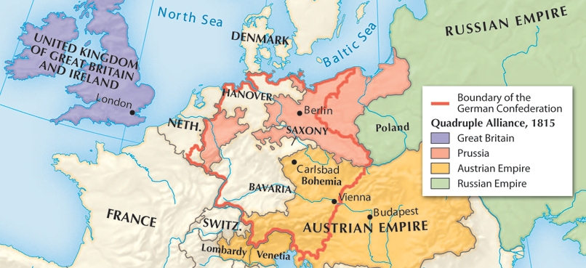
The architects of peace promoted the principle of legitimacy and restored monarchies in nations throughout Europe.
Austria, Russia, Prussia, and Britain formed the Quadruple Alliance to protect the new order.
They pledged to act together to maintain the balance of power and suppress revolutionary uprisings.

Slide 68
The creation of the Concert of Europe enabled the powers to meet periodically to address any new problems affecting the peace of Europe.
The Vienna statesmen created a general European peace that lasted for 100 years.
However, they did not foresee how nationalism would shake the foundations of Europe and Latin America in the next decades.

